Slide 1
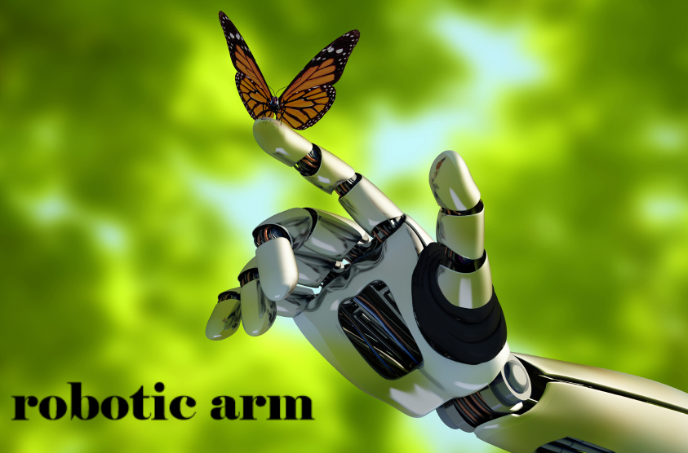

Slide 2
Agenda:
Analogy between human arm and robotic arm.
Development of robotic arms.
Types of robotic arms.
How do robotic arms move....(motors & sensors).
How to choose the material and dimensions of the arm... (importance of studying laws of motion).
PID control.
Applications in biomedical engineering.

Slide 3
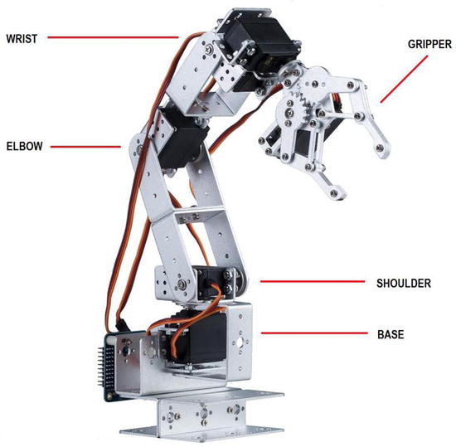
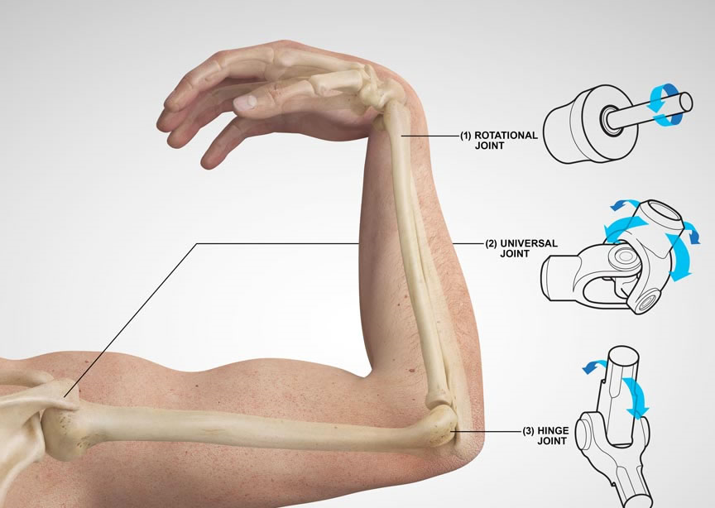
How does the robotic arm mimic the human arm???

Slide 4
History
1963
Rancho robotic arm
1954 Mr. Devol built on his own work in electrical engineering and machine controls to design a mechanical arm

Slide 5
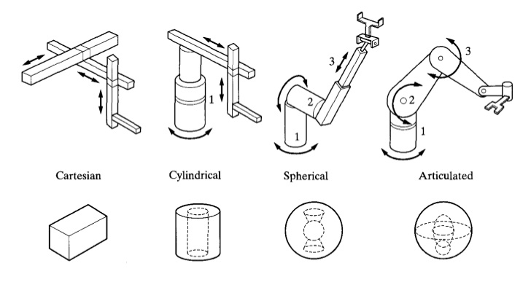
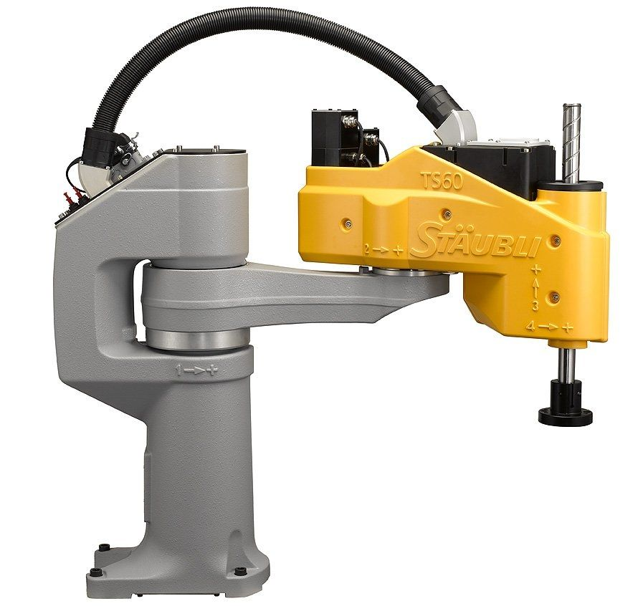
Types of robotic arms
There are several types according to the motion of the link around the joints (translational or rotational motion)

Slide 6
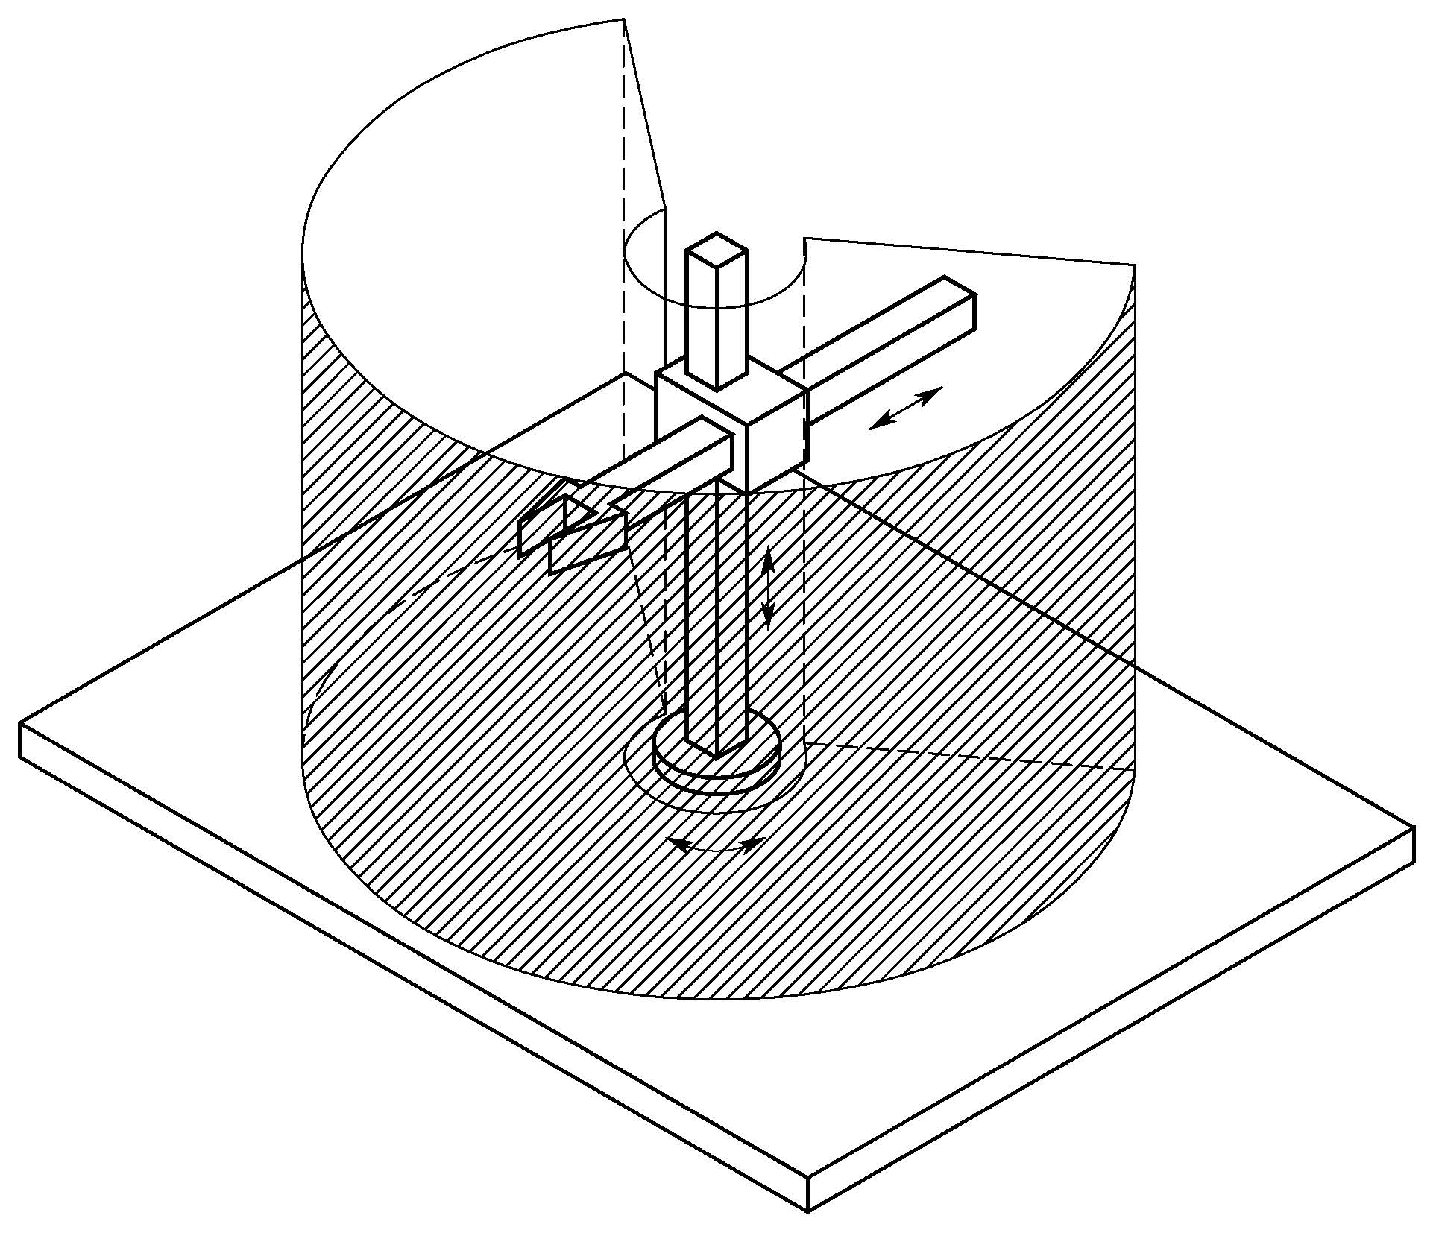
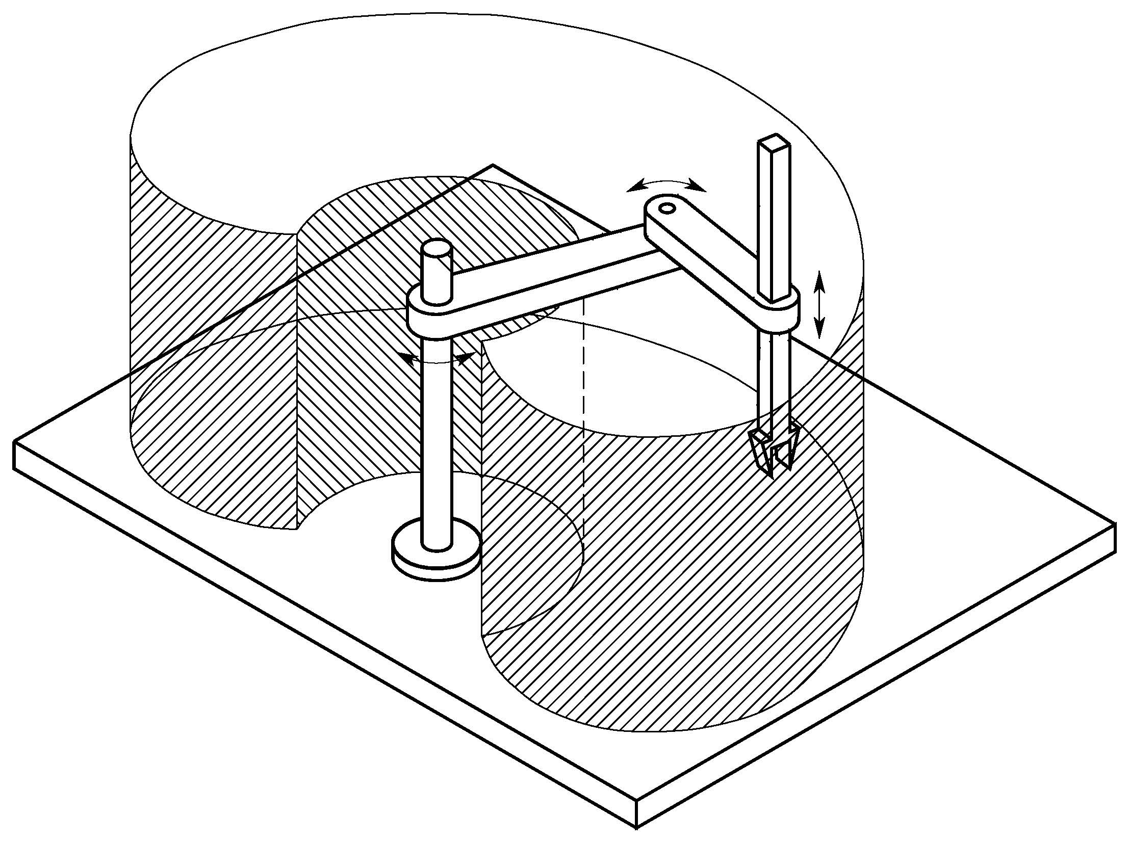
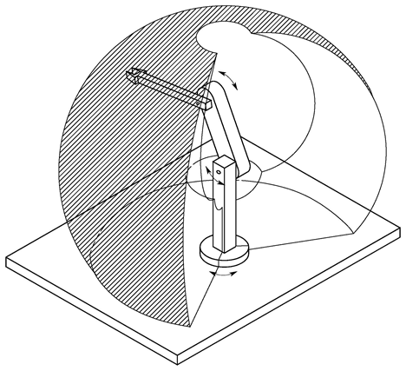
Types of Robotic arms (continue)
And accordingly... The workspace differs.
RRR
RRT
RTT

Slide 7


Now .. How can we design this robotic arm?? How can we choose the suitable dimension of the links?? Which materials can we use????
study the kinetics and kinematics

Slide 8
Kinetics and kinematics
Kinetics
It is concerned with the forces affecting the arm
Kinematics
It neglects the forces, and studies: 1.position 2.velocity 3.acceleration

Slide 9
1. Kinetics:
Newton Euler
Each link is treated separately
General formula: 1)$τ=ω×\left(Іω\right)+І\dot{ω}$ 2 )$F=ma$
General formula: 1)𝜏=𝜔×(І𝜔)+І𝜔 ̇ 2 )𝐹=𝑚𝑎
Euler Lagrange
The robotic arm is treated as a whole.
General formula: $\frac{d}{dt}$($\frac{∂L}{∂\dot{x}})−\frac{∂L}{∂x}=0$
$$,L=T−V$$
General formula: 𝑑/𝑑𝑡(𝜕𝐿/(𝜕𝑥 ̇ ))−𝜕𝐿/𝜕𝑥=0
,𝐿=𝑇−𝑉

Slide 10
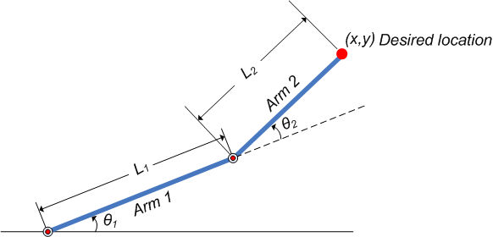
2. Kinematics:
Forward Kinematics
The angles between joints are given , so we can find the position of end effector
Inverse Kinematics
The final position of the end effector is given .. so we get the possible angles between links.

Slide 11
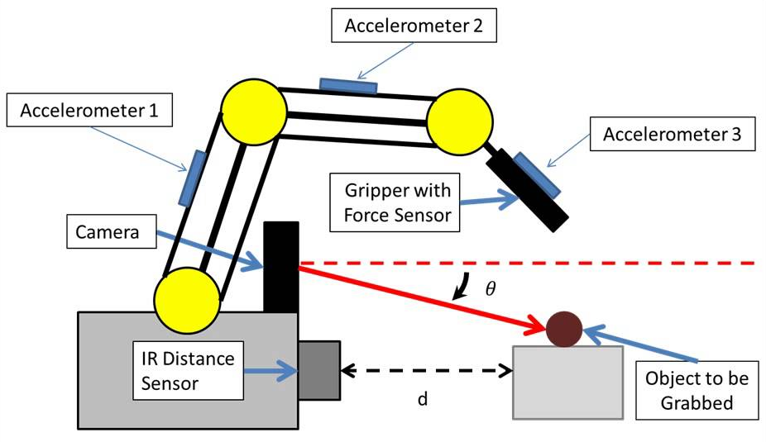
How does the robotic arm move???
1.sensors connect the arm to the environment.
2. Motors that cause motion.
3. Control

Slide 12
Control system
The thing that is responsible for the motion of robot is the control system. Control systems vary; there is an open loop system as well as a closed loop system. The open loop system is not based on the feedback unlike the closed loop system.
Open loop closed loop
computer controller
system driver or actuator
process or robot
servo
computer controller
system driver or actuator
process or robot

Slide 13
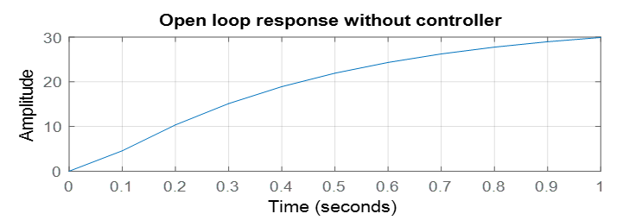
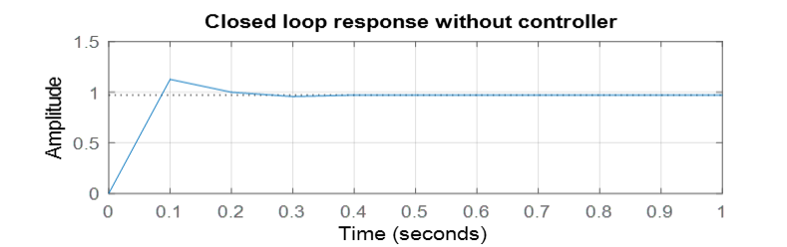
Open loop and closed loop using MATLAB toolbox
Closed loop
0pen loop

Slide 14

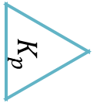



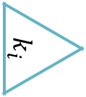
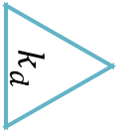
P I D
PROPORTION
INTEGRAL
DERIVATION
$$K_{p}$$
$$k_{p}∗error$$
$$k_{d}\frac{de}{dt}$$
reference value
+ -
error
d/dt
$$k_{d}$$
+
input volt
$$k_{i}\int{e dt}$$
measured value
$$\int{e dt}$$
$$k_{i}$$
Position sensor
actuator
Feedback control
Robotic
arm

Slide 15
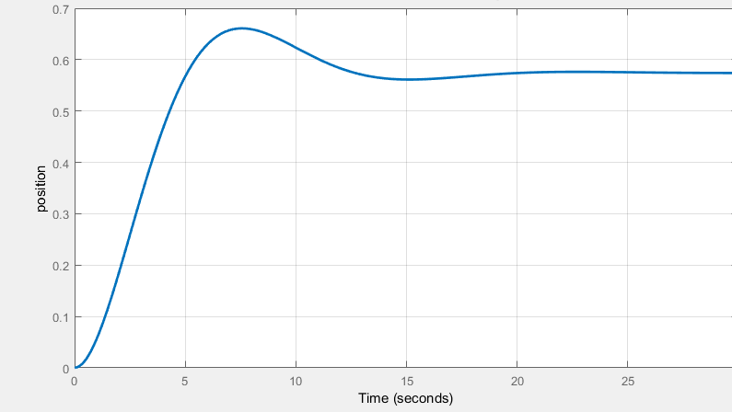
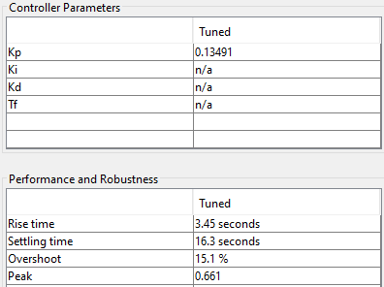
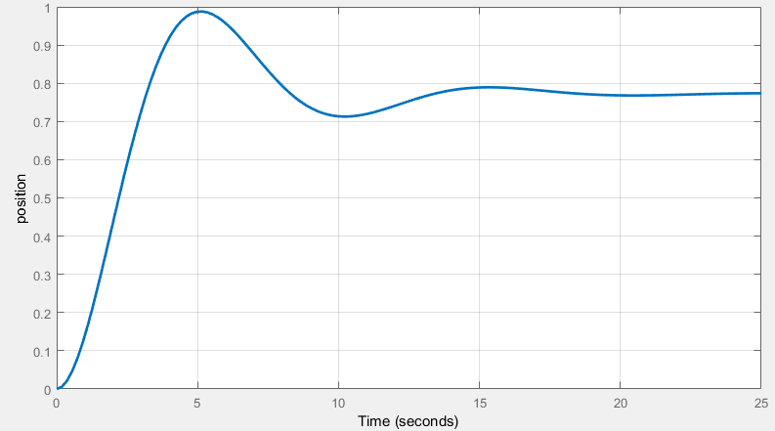
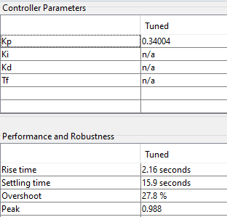
P Controller USING MATLAB TOOLBOX
Rising time=3.45 seconds
Rising time=2.16seconds
Over shoot=15.1 %
Overshoot= 27.8%
Increase kp lead to over shoot at a certain limit
Increase kp reduce the rising time

Slide 16
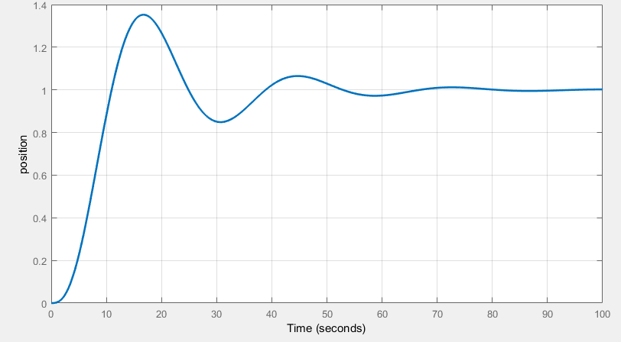
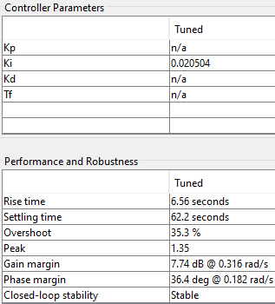
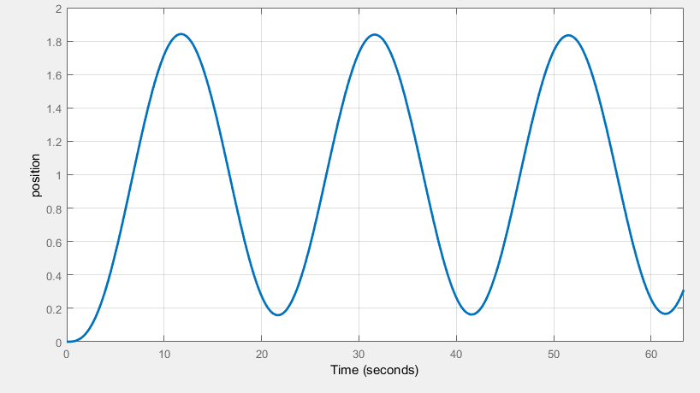
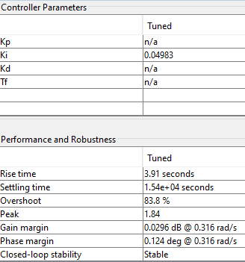
I Controller USING MATLAB TOOLBOX
Rising time =6.56, overshoot=35.3%
Rising time = 3.91 seconds,
Overshoot=83.8%
Increase ki increase the overshoot
After a certain value, Increase ki leading to oscillation
Increase ki making the system unstable
Reduce a rising time

Slide 17
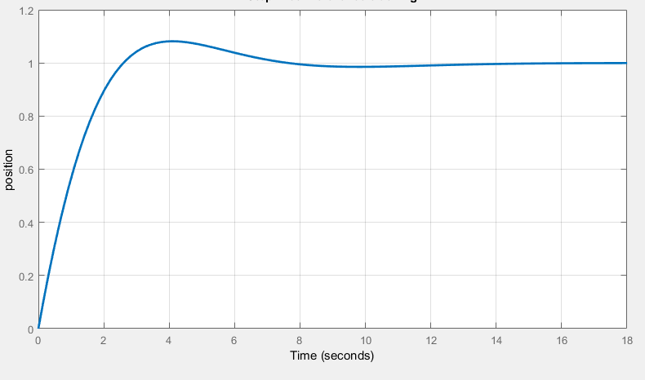
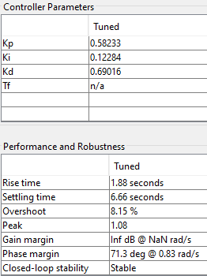
PID CONTROL USING MATLAB TOOLBOX
PID decrease the rising
PID decrease the overshoot by adjust gains

Slide 18
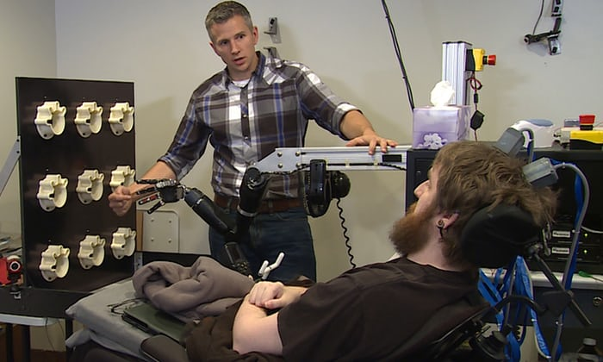
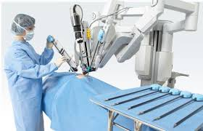
applications
Mind controlled prosthetic robot arm
Robotic Arm surgery

Slide 19
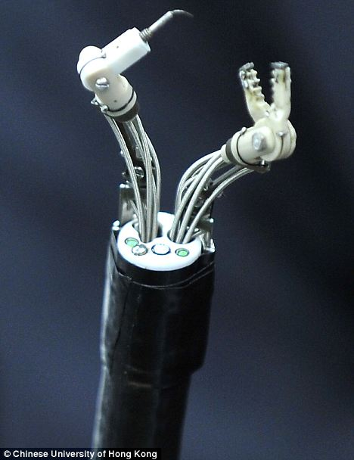
Applications(continue)
Mouth cancer treatment

Slide 20
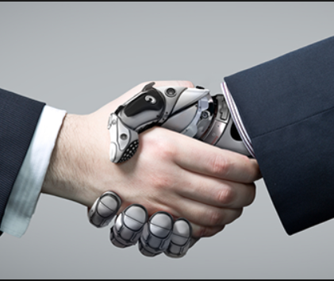


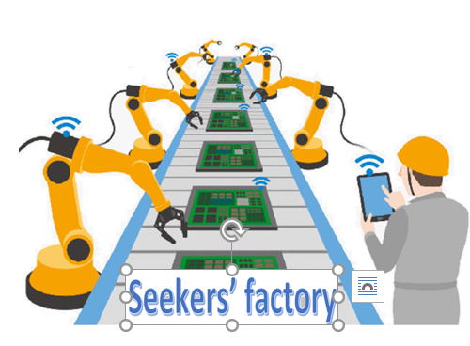

ROBOTIC ARM AND PROSTHETICS
RESEARCH
FACTORY
WEB SITE

Slide 21
Thanks for your Attention...

Slide 22
Prepared by:
Alzahraa Eid
Marina Maher
Esraa Khaled
Irini Adel
Supervised by:
Prof./Ahmed Gomaa

